Slide 1
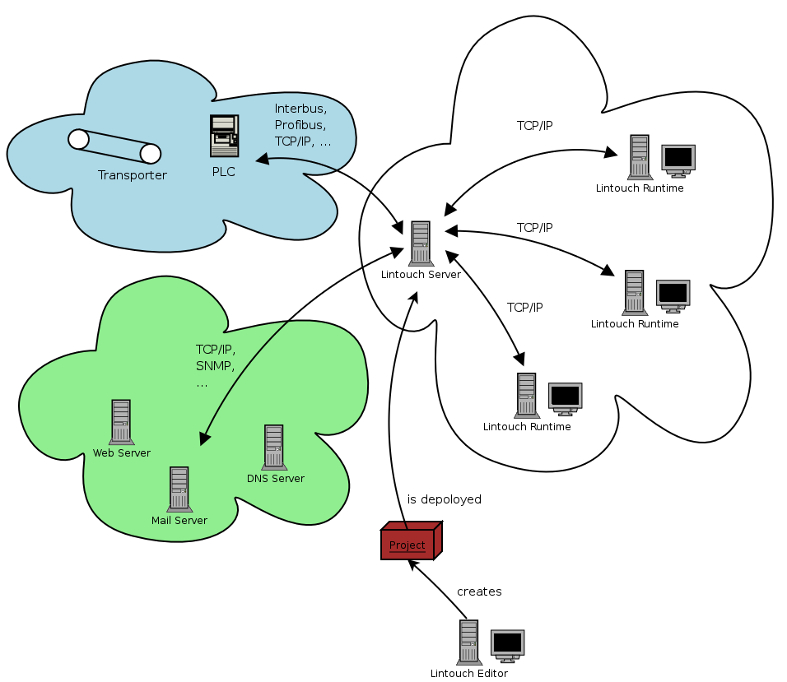

LINTOUCH IS...
Human Machine Interface (HMI)
open source
highly customizable
cutting deployment costs
powered by

Slide 2



LINTOUCH FEATURES
extensible design:
lintouch
Lua
ModBus
templates
plugins
SNMP
Basic
Exec
written in C for the speed, simplicity, and robustness
available for Windows and Linux
more at
http://www.lintouch.org
powered by

Slide 3
AutoHMI
Goal:
generate HMI from “other” sources of information
wiring diagram
PLC program
...
HMI
visualisation
objects
catalog
powered by

Slide 4
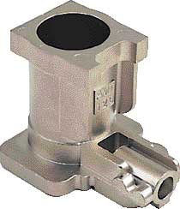
AutoHMI IN PRACTICE
PLC program
tagname list
HMI
"10YP3R ","A 47.2 ","BOOL ","Spanner 3 zurueck "
"10YP3RR ","M 943.7 ","BOOL ","10YP3R Roboter "
"10YP3RWz ","M 943.1 ","BOOL ","10YP3R Werkzeugstellung "
"10YP3V ","A 46.2 ","BOOL ","Spanner 3 vor "
"10YP3VR ","M 943.6 ","BOOL ","10YP3V Roboter "
pneumatic valve!
powered by

